Slide 1
Chapter 5
Process Synchronization
Examples

Slide 2
EX 5.12
The Linux kernel has a policy that a process cannot hold a spinlock while attempting to acquire a semaphore. Explain why this policy is in place.
Spinlocks are to only be held for short durations and a process that is sleeping may hold the spinlock for too long a period.

Slide 3
EX 5.13
Describe two kernel data structures in which race conditions are possible. Be sure to include a description of how a race condition can occur.
pid management system: it is possible two processes may be created at the same time and there is a race condition assigning each process a unique pid.
kernel process table: two processes are created at the same time and there is a race assigning them a location in the kernel process table.
scheduling queues: one process has been waiting for IO which is now available. Another process is being context-switched out. These two processes are being moved to the Runnable queue at the same time. Hence there is a race condition in the Runnable queue.

Slide 4
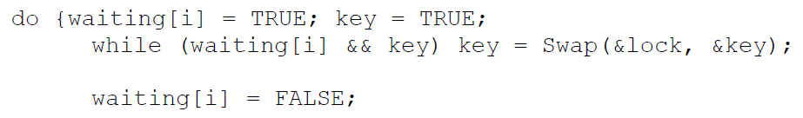

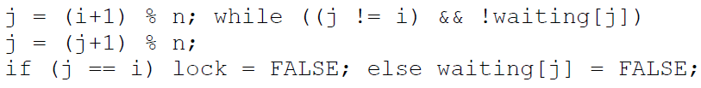
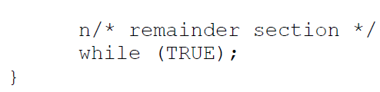
EX 5.14
Describe how the swap() instruction can be used to provide mutual exclusion that satisfies the bounded-waiting requirement.
Key = compare and swap(&lock, 0, &key)

Slide 5

EX 5.15
Consider how to implement a mutex lock using an atomic hardware instruction. Assume that the following structure defining the mutex lock is available.
  where (available == 0) indicates the lock is available; a value of 1 indicates the lock is unavailable.
  Using this struct, illustrate how the following functions may be implemented using the test_and_set() and compare_and_swap() instructions.
  • void acquire(lock *mutex)
  • void release(lock *mutex)
  Be sure to include any initialization that may be necessary.

Slide 6
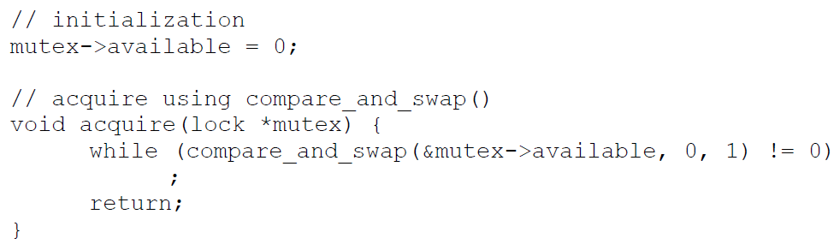
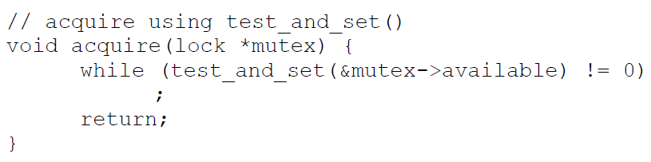
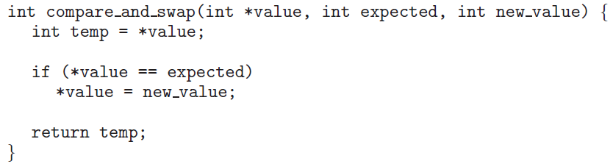
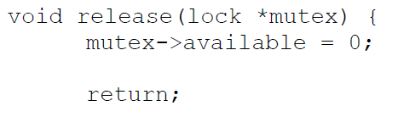
EX 5.15

Slide 7
EX 5.16
The implementation of mutex locks provided in Section 5.5 suffers from busy waiting. Describe what changes would be necessary so that a process waiting to acquire a mutex lock would be blocked and placed into a waiting queue until the lock became available.
Associated with each mutex lock would be a queue of waiting processes.
When a process releases the lock, it removes and awakens the first process from the list of waiting processes.

Slide 8
EX 5.19
A multithreaded web server wishes to keep track of the number of requests it services (known as hits.) Consider the following two strategies to prevent a race condition on the variable hits. The first strategy is to use a basic mutex lock when updating hits; second strategy is to use an atomic integer.
    int hits;
    mutex_lock hit_lock;
    hit_lock.acquire();
    hits++;
    hit_lock.release();
  Explain which of these two strategies is more efficient.
    atomic_t hits;
    atomic_inc(&hits);

Slide 9
EX 5.19
Locking generally requires a system call and possibly putting a process to sleep (and thus requiring a context switch) if the lock is unavailable.
On the other hand, the atomic integer provides an atomic update of the hits variable and ensures no race condition on hits. This can be accomplished with no kernel intervention and therefore the second approach is more efficient.

Slide 10
EX 5.23
Show how to implement the wait() and signal() semaphore operations in multiprocessor environments using the test_and_set() instruction. The solution should exhibit minimal busy waiting.
int guard = 0;
int semaphore_value = 0;
wait()
{
  while (TestAndSet(&guard) == 1);
  if (semaphore_value == 0) {
    atomically add process to a
    queue of processes waiting for
    the semaphore and set guard to 0;
  } else
  {
    semaphore_value--;
    guard = 0;
  }
}
signal()
{
while (TestAndSet(&guard) == 1);
if (semaphore_value == 0 &&
  there is a process on the wait queue)
  wake up the first process in the queue of waiting processes
else
  semaphore_value++;
  guard = 0;
}

Slide 11
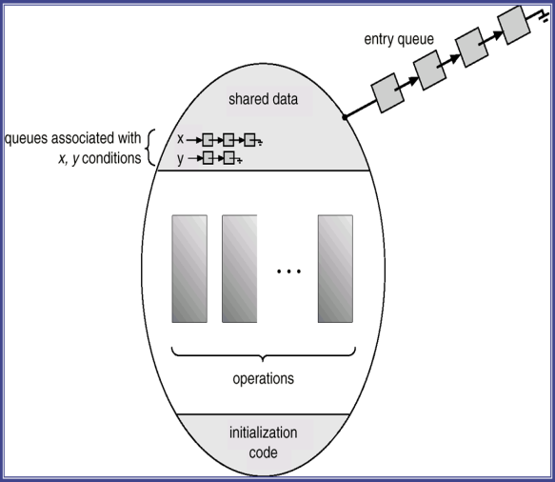
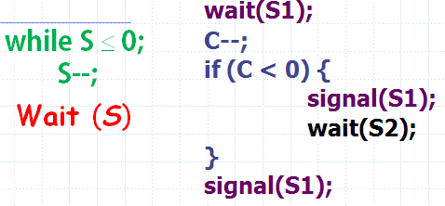
EX 5.25
Demonstrate that monitors and semaphores are equivalent insofar as they can be used to implement the same types of synchronization problems.
    monitor semaphore {
    int value = 0;
    condition c;
    semaphore_increment() {
    value++;
    c.signal();
    }
    semaphore_decrement() {
    while (value <= 0)
    c.wait();
    value--;
    }
    }
Implement a counting semaphore with 2 binary semaphores

Slide 12
EX 5.28
Discuss the tradeoff between fairness and throughput of operations in the readers-writers problem. Propose a method for solving the readers-writers problem without causing starvation.
Favoring readers could result in starvation for writers.
This problem could be avoided by keeping timestamps associated with waiting processes.
When a writer is finished with its task, it would wake up the process that has been waiting for the longest duration.
When a reader arrives and notices that another reader is accessing the database, then it would enter the critical section only if there are no waiting writers. These restrictions would guarantee fairness.

Slide 13
EX 5.31
Consider a system consisting of processes P₁, P₂, ..., P_{n}, each of which has a unique priority number. Write a monitor that allocates three identical line printers to these processes, using the priority numbers for deciding the order of allocation.
  monitor printers {
    int num_avail = 3;
    int waiting_processes[MAX_PROCS];
    int num_waiting;
    condition c;
    void release_printer() {
      num_avail++;
      c.broadcast();
    }

Slide 14
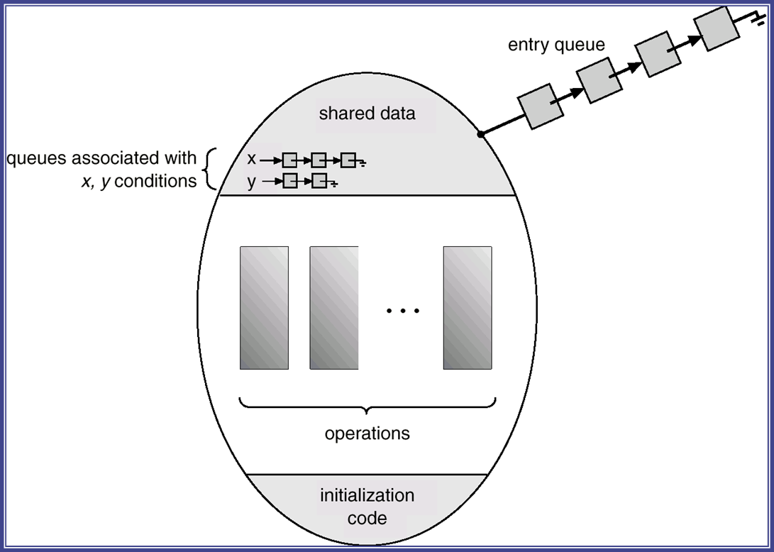
EX 5.31
  void request_printer(int proc_number) {
    if (num_avail > 0) {
    num_avail--;
    return;
    }
    waiting_processes[num_waiting] = proc_number;
    num_waiting++;
    sort(waiting_processes);
    while (num_avail == 0 &&
      waiting_processes[0] != proc_number)
    c.wait();
    waiting_processes[0] =
      waiting_processes[num_waiting-1];
    num_waiting--;
    sort(waiting_processes);
    num_avail--;
  };
num_avail ≥ 0

Slide 15
EX 5.35
Design an algorithm for a monitor that implements an alarm clock that enables a calling program to delay itself for a specified number of time units (ticks). You may assume the existence of a real hardware clock that invokes a function tick() in your monitor at regular intervals.
  monitor AlarmClock {
    int now=0;
    condition wakeup;
    wakeme(int n) {
      int alarm;
      alarm = now + n;
      while (now < alarm) wakeup.wait(alarm);
      wakeup.signal;
    }
    tick() { /*invoked automatically by hardware*/
    now = now + 1;
    wakeup.signal;
    }
  }
Notes:
Wait in the wakeup queue.
“now” is a shared variable, invoked and updated by hardware.
wakeup.signal will wakeup the processes of the queue, one by one.

